Slide 1
Violent Weather
Thunderstorms

Slide 2
Thunderstorms
Pre-Requisites
Thunderstorm Classification
Thunderstorm Hazards:
Downbursts & Microbursts
Tornadoes
Lightning

Slide 3
Pre-Requisites
All thunderstorms require three ingredients for their formation:
Moisture,
Instability, and
a Lifting Mechanism.
Florida is ideally placed to routinely satisfy all of these conditions…

Slide 4
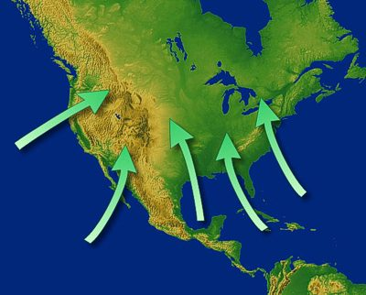
Florida has two ready sources of moisture: Atlantic Ocean & Gulf of Mexico
Sub-Tropical temperatures will regularly facilitate atmospheric instability
Temp’s provide frontal & convectional Lifting

Slide 5
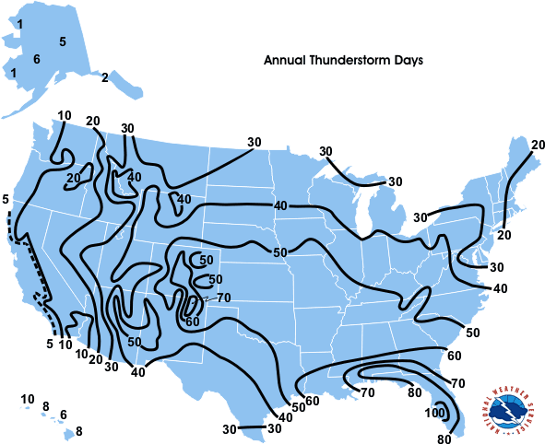

Slide 6
Thunderstorm Classification
Air Mass Thunderstorms
A.K.A.
Ordinary
Most common form of thunderstorm
Self-Extinguishing
Wipe themselves out with downdrafts
Usually last < 1 hour
Single-cell storms
Localized
Undergo a 3-Stage Life Cycle…

Slide 7
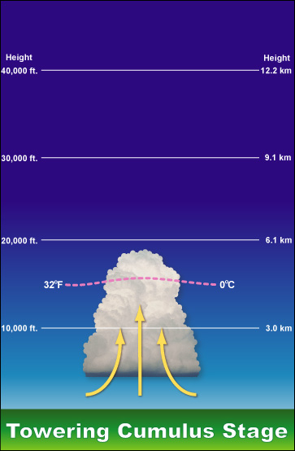
Life Cycle
Cumulus Stage
Convectional lifting causes warm, moist air to cool. Leading to growth of tall cumulus clouds.
Updrafts of hot air keep droplets moving upwards, making any potential raindrops larger…
This stage continues until precip. begins

Slide 8
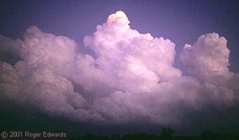

Slide 9
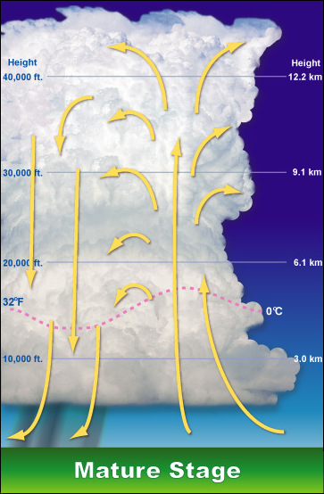
Life Cycle
Mature Stage
Precipitation begins.
With falling drops downdrafts begin.
Cooling occurs by evaporation of precipitation
Strengthens downdrafts.
Most intense period of Thunderstorm (Lightning/Thunder/ Precipitation)

Slide 10
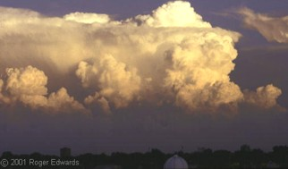

Slide 11
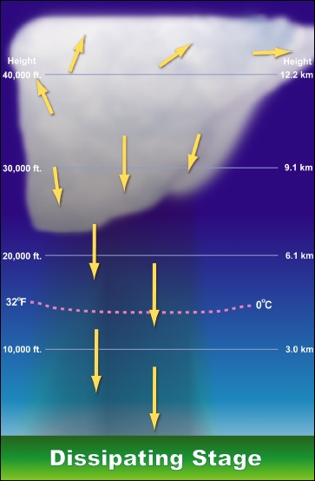
Life Cycle
Dissipative Stage
Greater & Greater portions of the cloud produce precipitation
This means that downdrafts dominate the cloud base
In turn, this prohibits updrafts.
Thus, the supply of additional water vapor is cut-off.
The cloud precipitates/ evaporates away

Slide 12
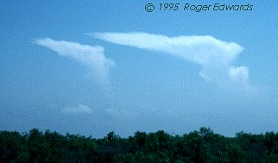

Slide 13
Thunderstorm Classification
Severe Thunderstorms
A.K.A.
Self-Propagating
Subtypes include:
Mesoscale Convective Systems
Squall Line Thunderstorms
Mesoscale Convective Complexes
Supercell Thunderstorms

Slide 14
Thunderstorm Classification
Severe Thunderstorms
Definition:
Winds over 58 mph (93 km/h), and/or
Hailstones over 1.9 cm (0.75 inches), and/or
Spawn Tornadoes
Updrafts & downdrafts reinforce each other, so storm keeps intensifying
Takes place on a Mesoscale
10-1000km across

Slide 15
Thunderstorm Classification
Mesoscale Convective Systems
Several individual storms form, clustered together in a large geographic area
A.K.A. Multi-Cell Storms
Each is related to the others in some way
Can last anywhere from 10 hours to several days!
When they form:
In linear bands, they are known as SQUALL LINES
In clusters, known as Mesoscale Convective COMPLEXES

Slide 16
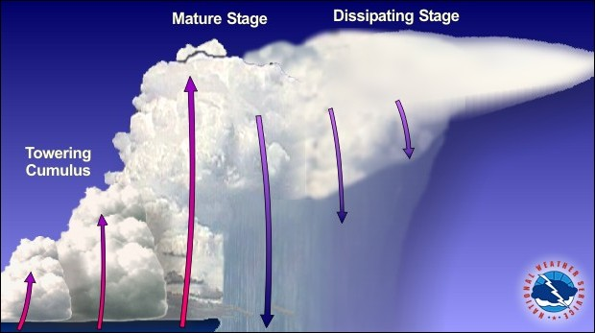
Each of these numerous cells will co-exist in various stages of their Life Cycle.

Slide 17
Thunderstorm Classification
Squall Line Storms
Linear band of storms
Can stretch for hundreds of miles and may last anywhere from 10 hours – 4 days!
Wind Shear is critical to the maintenance of updrafts that refuel the storms moisture supply.
The difference in wind speed and direction.

Slide 18
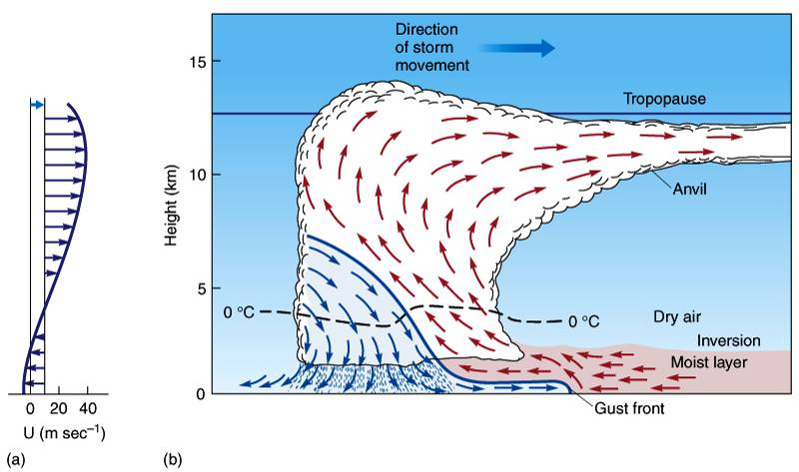
A ‘Gust Front’ of cold air down drafting from the storm spreads ahead of the squall line and acts as a mini cold front, continually lifting warm moist air to fuel the storms. (Fig. 11-14 p. 320)

Slide 19
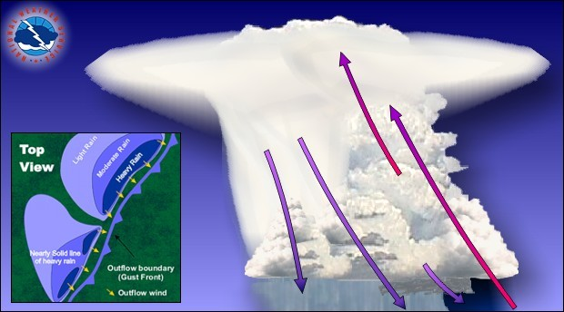
Squall Line

Slide 20
Thunderstorm Classification
Mesoscale Convective Complexes (MCC)
When MCS form as circular groupings (rather than linear squall lines) they’re known as MCC
They ‘feed’ from each other’s outflows of cool, wet air (same outflow as in squall line storms)
Can be seen dissipating and reforming over time and distance

Slide 21
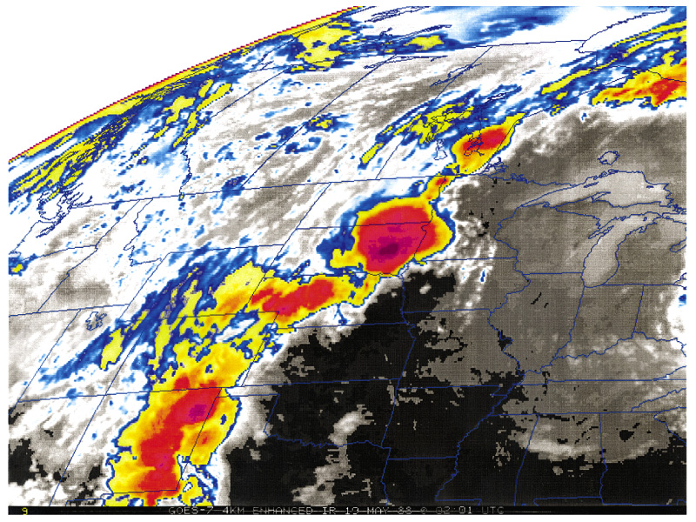
Mesoscale Convective Complex over eastern South Dakota (Fig. 11-9 p. 317)

Slide 22
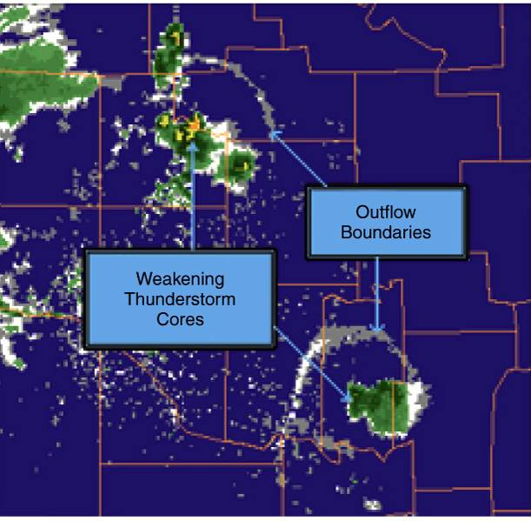
Radar Imagery Depicting Outflow Boundaries
These will often fuel adjacent storm cells.
(Fig. 11-10 p. 317)

Slide 23
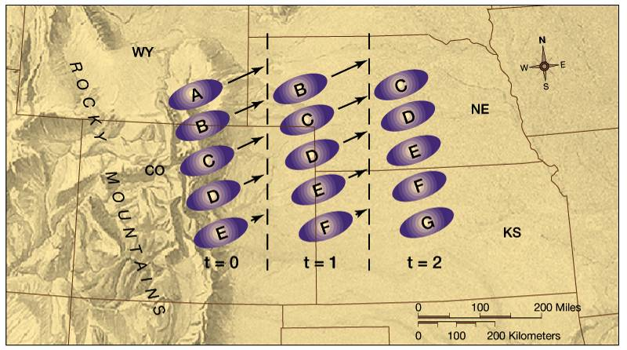
As the MCC migrates to the NE, the outflow of each cell propagates its neighbors. The oldest cell, on the northern end of the chain, will dissipate only to be replaced by a new cell at the south end. (Fig. 11-11 p. 319)

Slide 24
Recall…

Slide 25
Thunderstorm Classification
Supercell Storms
Extremely violent, though smaller and shorter-lived than MCS storms
Form the majority of very large tornadoes
Typical lifespan is 2-4 hours
Characterized by a rotating updraft
Product of very strong vertical wind shear
Rotation is often visible from the ground.

Slide 26
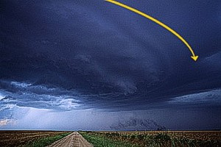
Supercells are characterized by rotational updrafts

Slide 27
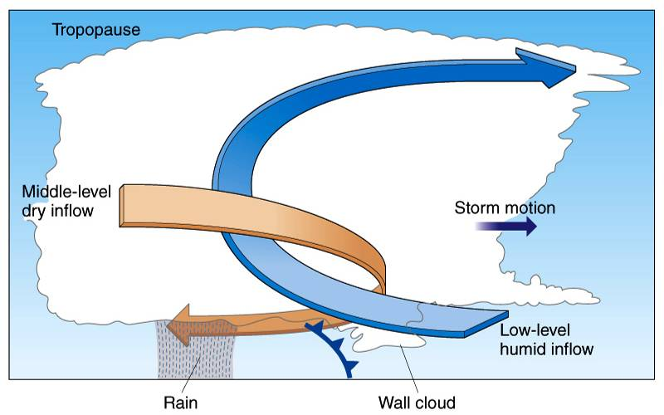
Vertical Wind Shear is critical to the development of Supercells (Fig. 11-18 p. 322)

Slide 28
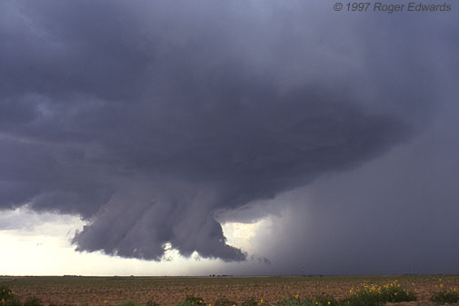
Cool Moist air from Downdraft gets into . Updraft and Saturates closer to ground. . Wall Clouds are often indicative of Tornado Development

Slide 29
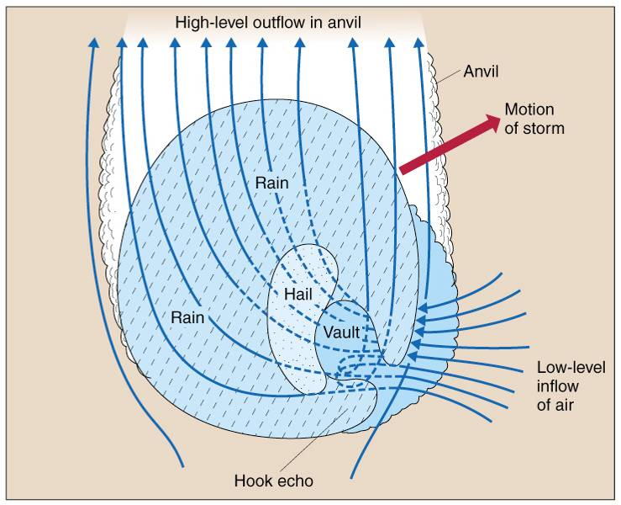
Plan View of Air Inflow
Strongest Zone of Updraft is the Vault.
Radar will fail to detect this region. Drops too small.
(Fig. 11-19a p. 323)

Slide 30
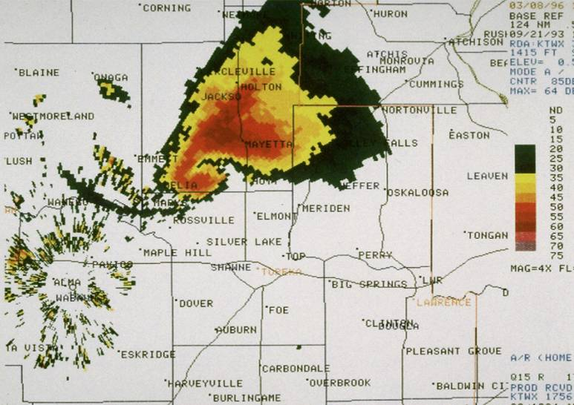
Doppler Radar Image. To the south of the Vault ‘Hole’ is the ‘Hook’. This serves as an indicator of a potential Tornado (Fig. 11-19b p. 323)

Slide 31
Thunderstorm Hazards
Downbursts, Microbursts
Simply very strong downdrafts
Strong gusts of wind that can reach 165mph
Creating strong horizontal winds in any direction.
Can cause severe damage (equivalent to medium Tornado)
Microbursts are less than 2.5 mi in diameter
Especially dangerous near airports

Slide 32
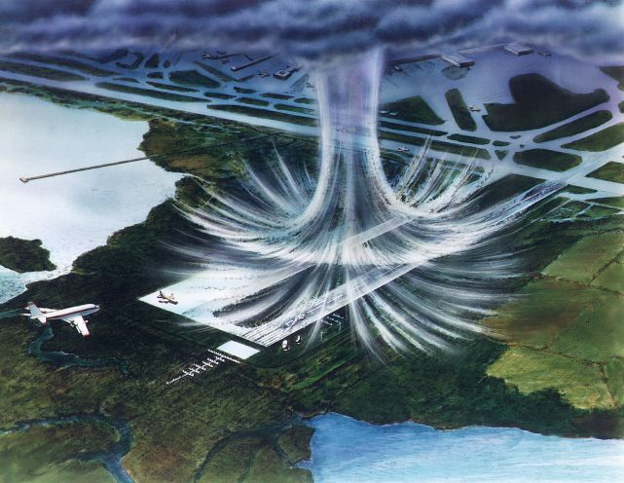

Slide 33
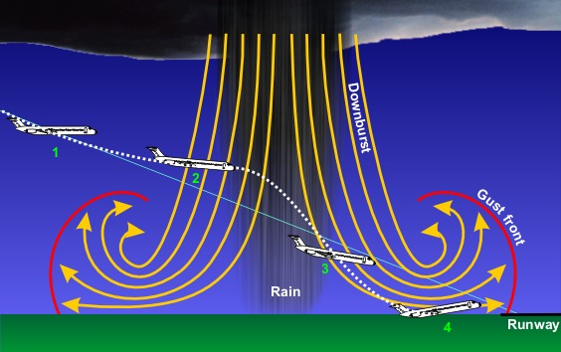
A Microburst will initially create more lift than desired for a plane on final approach. This causes the pilot to compensate. As the plane enters the ‘tailwind’ portion of the downburst, lift is reduced, and the pilot is left w/ insufficient recovery time

Slide 34
Tornadoes
Definition & Characteristics
Generalities
Classification
Formation

Slide 35
Tornadoes
Definition & Characteristics
Extremely rapid rotating column of air beneath the base of Cumulonimbus cloud.
Mostly cyclonic
But not ALWAYS counterclockwise in N Hemisphere…
Huge Pressure change over very short distance creates huge PGF and incredibly FAST winds
As much as 100mb from the core to the area just outside the funnel.
Appearance varies from rope-like to funnel-shaped
Must be touching ground to be true tornado

Slide 36
Tornadoes
Generalities
Typically are short-lived lasting only a few minutes; sometimes can last several hours
Diameter 100 to 1500 yards
Forward motion approximates 30 mph
Minimum wind speed 40 mph; max over 300 mph

Slide 37
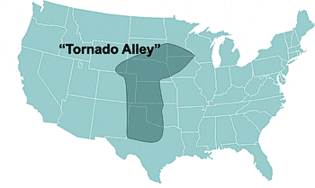
Tornado Alley: More Tornadoes strike the central US than any other place in the world

Slide 38
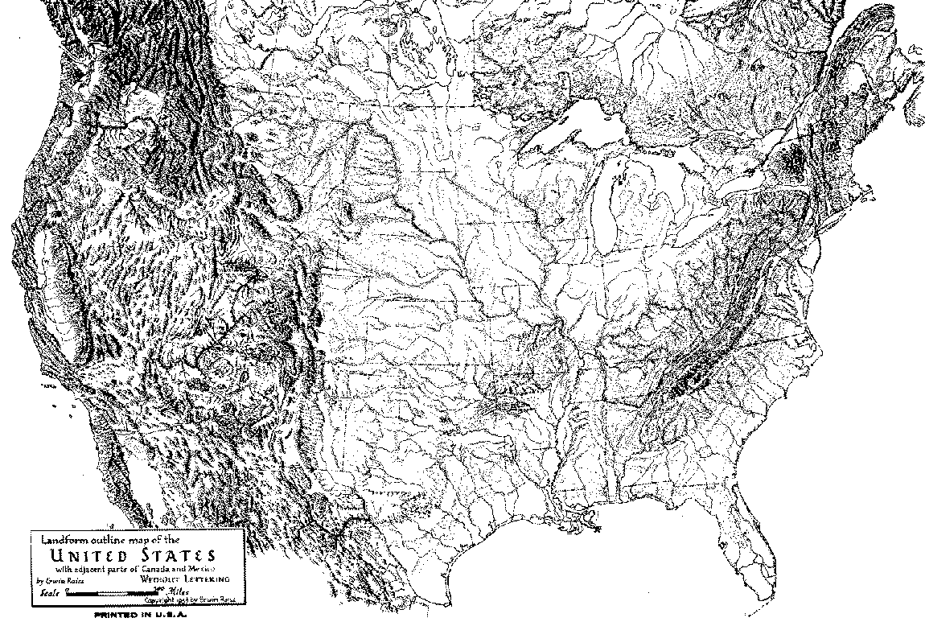

Slide 39
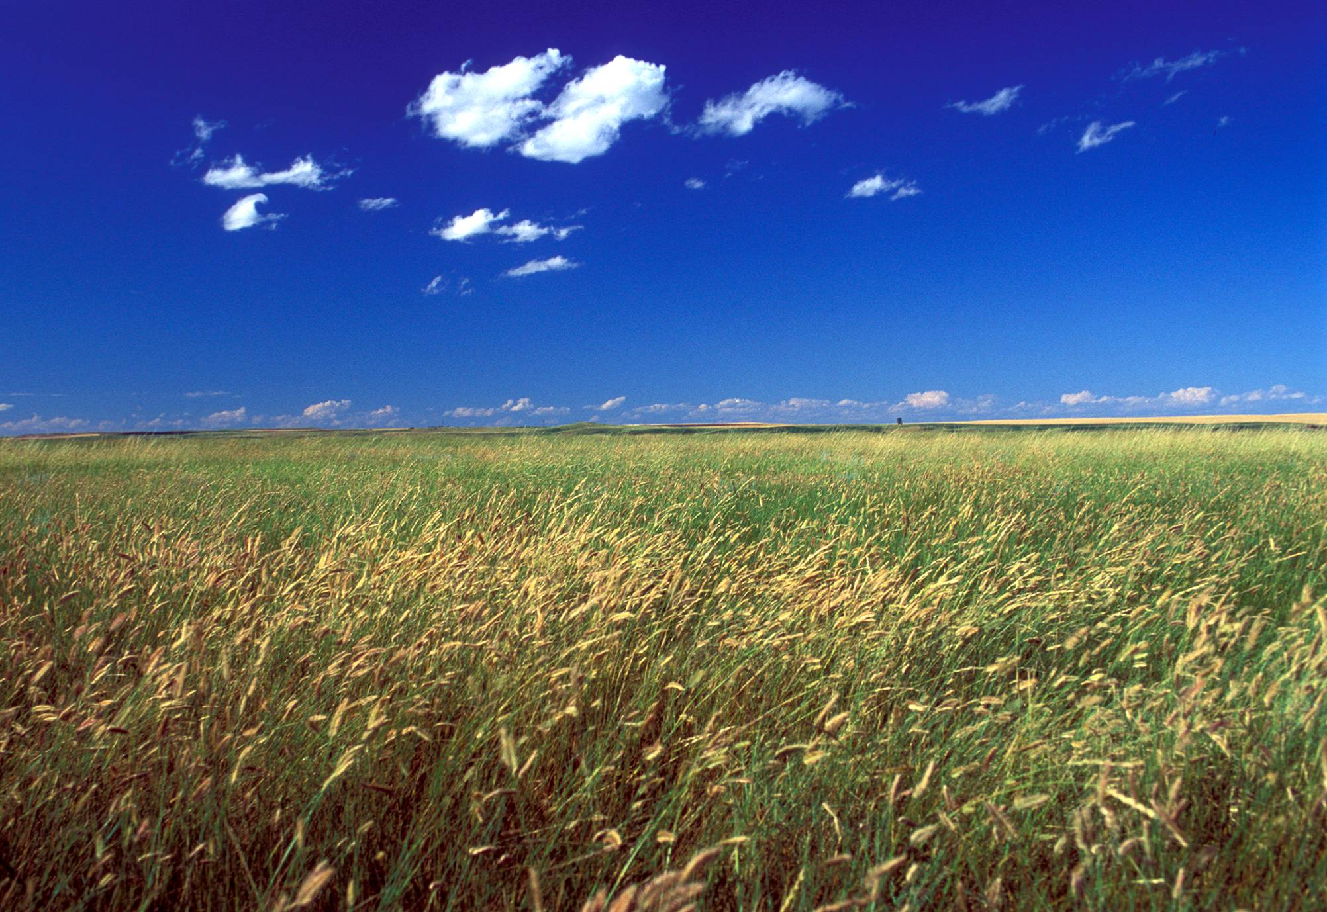
The Great Plains – South Dakota Extensive area of gently rolling and flat terrain with excellent soils and some of the worlds most productive farms. Slopes gradually upward towards the Rockies.

Slide 40
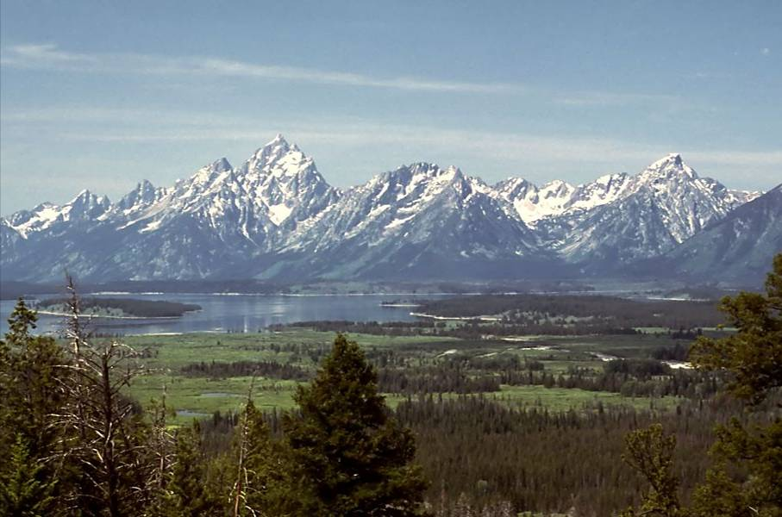
The Rocky Mountains – Teton Range, Wyoming Stretch from British Columbia, Canada to New Mexico, USA.

Slide 41
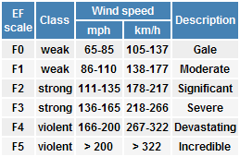
Tornadoes
Classification
Based upon the Fujita Intensity Scale
mostly based on wind-speed estimated by assessment of damage

Slide 42
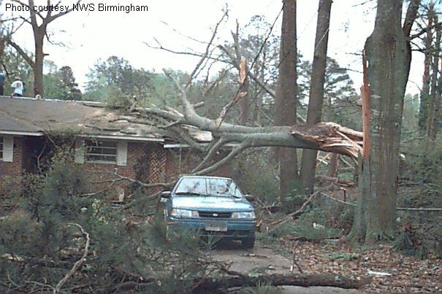
Damage: F0 (65 – 85 mph)
Some damage to chimneys; branches broken off trees; shallow-rooted trees pushed over; sign boards damaged.

Slide 43
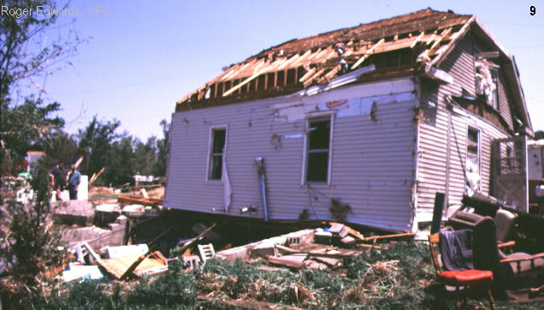
Damage: F1 (86 – 110 mph)
Peels surface off roofs; mobile homes pushed off foundations or overturned; moving autos blown off roads.

Slide 44
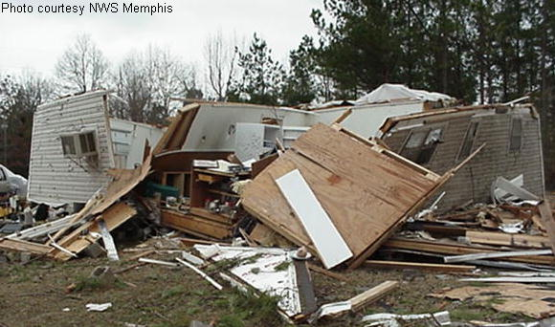
Damage: F2 (111 – 135 mph)
Roofs torn off frame houses; mobile homes demolished; boxcars overturned; large trees snapped or uprooted; light-object missiles generated; cars lifted off ground.

Slide 45
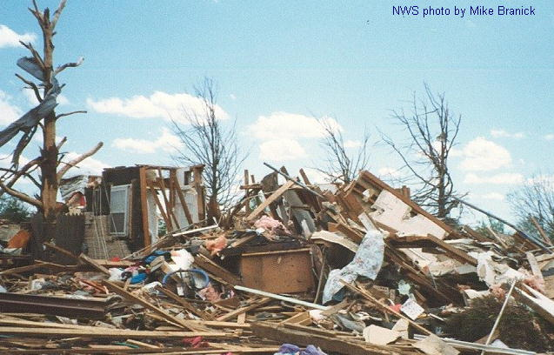
Damage: F3 (136 – 165 mph)
Roofs and some walls torn off well-constructed houses; trains overturned; most trees in forest uprooted; heavy cars lifted off the ground and thrown.

Slide 46
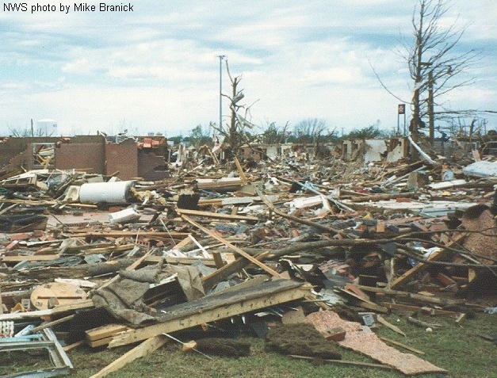
Damage: F4 (166 – 200 mph)
Well-constructed houses leveled; structures with weak foundations blown away some distance; cars thrown and large missiles generated.

Slide 47
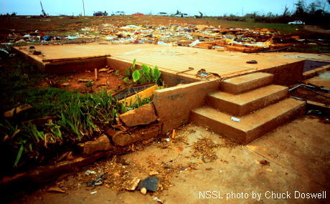
Damage: F5 (> 200 mph)
Strong frame houses leveled off foundations and swept away; automobile-sized missiles fly through the air in excess of 100 meters (109 yds); trees debarked; incredible phenomena will occur.

Slide 48
Tornadoes
Formation
Can form in any severe weather situation:
Cold fronts, Squall lines, MCCs, Supercells, Drylines, Mid-latitude & Tropical Cyclones
Processes that lead to Tornado Development are NOT well understood!
Most intense and destructive tornadoes form from Supercells…

Slide 49
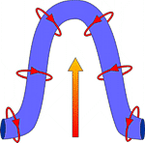
Tornadoes
Formation
As a Supercell passes overhead, winds aloft are in a different direction than those at the surface ie. Wind shear.
This wind shear creates a column of rotating air at the surface.
Updrafts lift the rotating column, resulting in cyclonic (Mesocyclone) & anti-cyclonic rotation

Slide 50
Tornado Wind Patterns
Notes:
To view this animation, click “View” and then “Slide Show” on the top navigation bar.

Slide 51
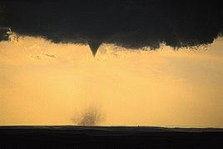
Funnel Cloud: Water Vapor within the rotating air condenses making it visible to the eye. Winds are equal to those of a Tornado. However, it is not termed a Tornado until…

Slide 52
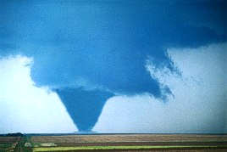
…It comes into contact with the ground. The color of the Tornado is dependant upon the type of dirt/debris it moves over (red dirt produces a red tornado, black dirt a black tornado, etc.)

Slide 53
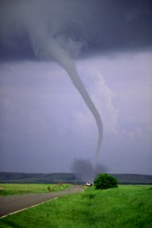
As the tornado dissipates:
It will decrease in size
Become increasingly tilted with height, and
Will take on a contorted, rope-like appearance.

Slide 54
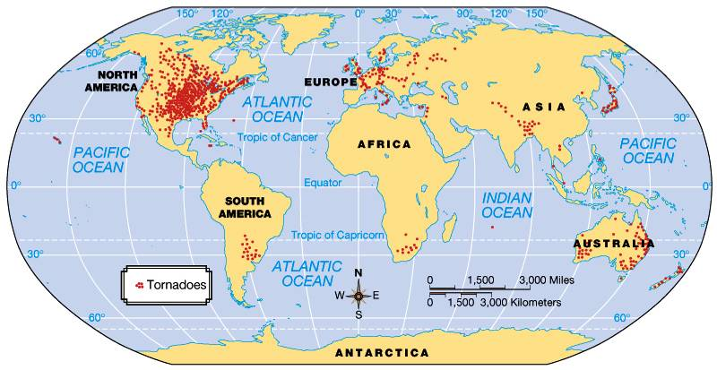
Fig. 11-20 p. 335

Slide 55
Thunder & Lightning
Lighting is produced by a difference in “charge” between the cloud and the ground
First lets explain the basics of electrical currents

Slide 56
Electrical Circuits
Electrons are negatively charged
If atom gains/loses electron it becomes “charged”, called an ION
In metal only Electrons can flow so current actual flows from – to +
not + to – like conventionally thought
In other substances like air or the human body actual ions can flow
can flow + to –, – to + or both!

Slide 57
Chemical Battery
Battery consists of two chemicals separated by barrier which inhibits the chemicals from mixing but allows flow of ions
One chemical attracts positive ions and the other side attracts negative ions
This allows electrical current to flow when circuit connected to battery

Slide 58
Thunder & Lightning
Charge Separation
The separation of Positive and Negative charges
In clouds, positive charges accumulate at the top and negative at the bottom
How this occurs is not fully understood.
However, Lightning will occur in clouds that:
Extend above the freezing level, and
Are Precipitating
Thus, it seems to have something to do with ice crystal process responsible for precipitation.

Slide 59
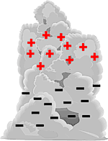
Thunder & Lightning
Charge Separation
Seemingly, as Ice Crystals and Hailstones collide:
Ice Crystals (which mostly remain aloft) transfer a negative charge (an electron) to the Hailstone
The negatively charged Hailstone falls through the cloud leaving the now positively charged Ice Crystal aloft.

Slide 60
Thunder & Lightning
Cloud-to-Cloud Lightning
As the Charge Separation increases, an electric field is generated
The greater the separation, the stronger the field!
However, the atmosphere is an excellent insulator that inhibits the flow of electricity
Thus the Charge Separation must be tremendous prior to the occurrence of Lightning.
Which, of course, is exactly what occurs when this critical threshold is reached…

Slide 61
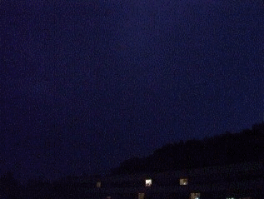

Slide 62
Thunder & Lightning
Cloud-to-Ground Lightning
An electric field is ALSO generated between:
the negatively charged cloud base, and
A pool of positively charged ions that collect on the surface beneath the cloud
These ions are attracted by the storm and will shadow its movement
This field is not as strong as the one in the cloud which is why the majority of Lightning is of the C-to-C variety

Slide 63
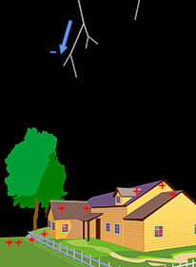
Thunder & Lightning
The Motion of a Strike
The Stepped Leader
A very faint (invisible to the eye), negatively charged channel of ionized air that makes a series of steps towards the surface
Each step is about 50 meters
Between each step is a pause (1 microsecond) as a charge accumulates at the tip

Slide 64
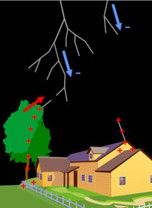
Thunder & Lightning
The Motion of a Strike
Streamers
As the Stepped Leader approaches the surface it induces a positive electric channel up from the ground
These are called Streamers

Slide 65
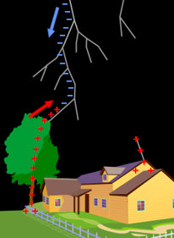
Thunder & Lightning
The Motion of a Strike
Stroke
Once the Streamer connects with the Stepped Leader (100 – 300 ft off the ground)
The negative charge starts to flow DOWN the established channel

Slide 66
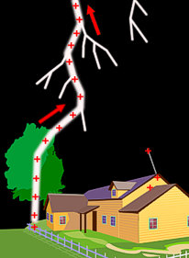
Thunder & Lightning
The Motion of a Strike
Return Stroke
At the same time, an electric current wave shoots UP the channel as a brilliant pulse.
This ‘Return Stroke’ accounts for 99% of a lightning bolts luminosity.
Thus the stroke flows FROM the ground TO the cloud!

Slide 67
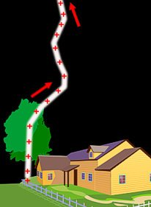
Thunder & Lightning
The Motion of a Strike
Dart Leader
Upon completion of the ‘Return Stroke’, any remaining Charge may flow down the existing channel as a ‘Dart Leader’
This causes a flickering appearance.
Not branched like the initial stroke

Slide 68
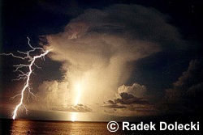
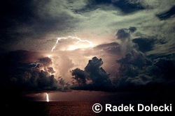
What was described before is called “negative lightning” because there is a net transfer of negative charge from the cloud base to the ground
When lightning originates in the upper part of the cloud, however, it is termed “positive lightning”
Because positive lightning must travel through a greater region of the atmosphere the resistance offered by the atmosphere is greater: making them relatively rare (less than 5% of strikes)

Slide 69
But it also means that when they do strike they are MUCH more dangerous than their negative cousins (10x as powerful as negative lightning!)
Furthermore, they can strike the ground up to 10 MILES AWAY from the storm where you may not perceive any danger or hear any Thunder!

Slide 70
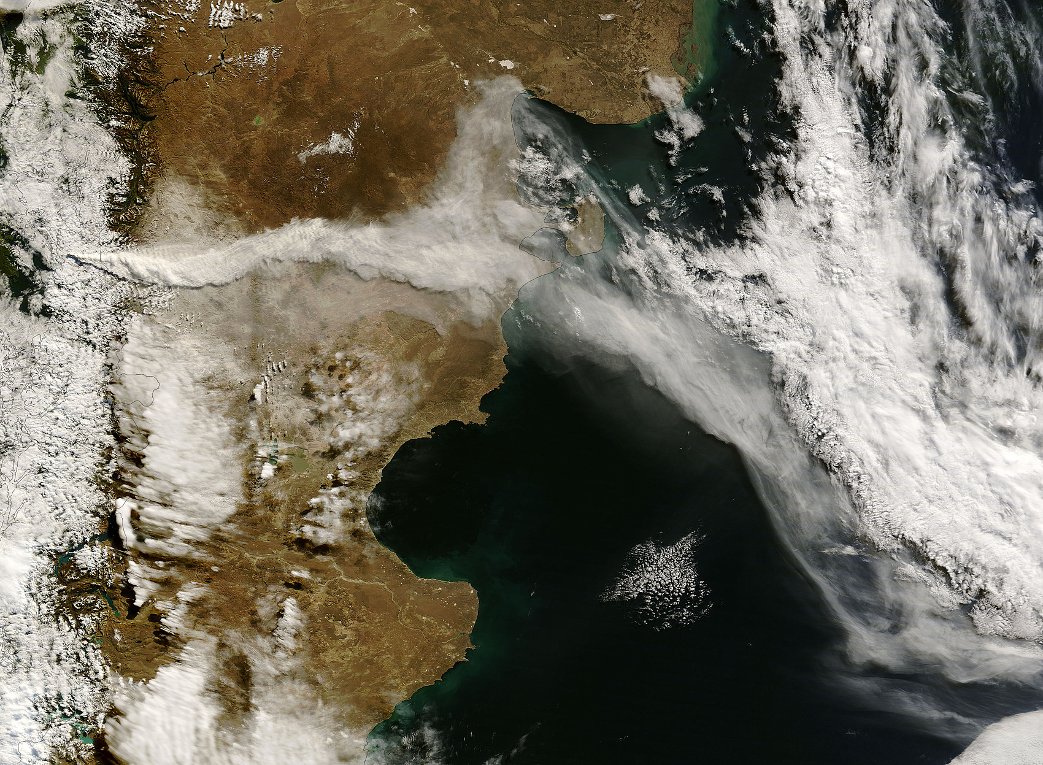
Chaiten Volcano, Chile – May 3, 2008

Slide 71
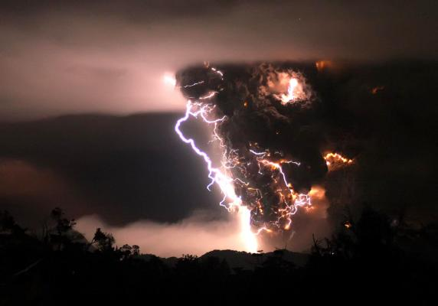
Chaiten Volcano, Chile – May 3, 2008: Triggered Lightning

Slide 72
Thunder & Lightning
Thunder
The acoustic shock wave resulting from the extreme heat generated by lightning.
Lightning heats the surrounding air to a temperature (30,000°C) 5X the surface of the Sun!
This causes the air to expand EXPLOSIVELY!
It expands so rapidly, it compresses the air in front of it, forming a ‘shock wave’
Similar to a ‘sonic boom’ : happens when source of sound moves faster than speed of sound

Slide 73
Thunder & Lightning
Thunder
‘Shock Waves’
When this occurs nearby, it will sound like a loud bang, crack or snap.
However, as distance increases, the ‘shock wave’ stretches and is joined by other shockwaves formed by different points along the same bolt
This combination of shockwaves creates the familiar rumbling sound.
By counting the seconds between lightning & thunder, and then dividing by 5, it is possible to determine the distance of the storm in miles

Slide 74
SPOT Use MyFau (Not Paper)

Slide 75
SPOT
Instructor: Aaron Evans
Course #: MET 2010
Call #: 55860
Semester: Summer 2012

